Slide 1
Azure DATA FACTORY

Slide 2
Pre-ReQuisite
Set up Free/Pay as you Go Azure Account
Basic Idea of Azure Storage

Slide 3
Types of Azure Storage
Blob- Allows unstructured data to be stored and accessed at a massive scale in block blobs
File: Fully managed cloud file shares that you can access from anywhere via the industry standard Server Message Block (SMB) protocol, Network File System (NFS) protocol
Queue :Allows for asynchronous message queueing between application components.
Table :Allows you to store structured NoSQL data in the cloud, providing a key/attribute store with a schemaless design

Slide 4
Agenda
What is ADF
Why ADF
Discuss an example to better understand this

Slide 5
What is Azure data Factory(ADF) & WHY ADF
ADF is a cloud-based ETL and data integration service that allows you to create data-driven workflows for orchestrating data movement and transforming data at scale.
In the world of big data, raw, unorganized data is often stored in relational, non-relational, and other storage systems but on its own these raw data does not have any context.
Big data requires a service that can orchestrate and operationalize processes to refine these enormous stores of raw data into actionable business insights. Azure Data Factory is a managed cloud service that's built for these complex hybrid extract-transform-load (ETL), extract-load-transform (ELT), and data integration projects

Slide 6
Quick Usage SCENARIO
A large gaming company collects petabytes of logs that are produced by games in Cloud
Customer Information , Game Information and Marketing Information stored in On Premise Database
Company wants to combine On prem and Cloud data to build an analogy for up-sell, cross-sell, developing new features which can build business growth
ADF will help to solve this scenario with creating Pipelines to pull data from datasets, transform and push to cloud Datawarehouse like blob, ADLS Gen2

Slide 7
Features of ADF
Data Compression
Extensive connectivity support for numerous data sources.
Data Preview and Validation
Customizable data flows
Security

Slide 8
HOW THINGS WORKS
Connect & Collect
Transform and Enrich
CI/CD and Publish
Monitor

Slide 9
Top level concepts
Pipelines
Linked Service
Datasets
Activities
Dataflow
Integration Runtime
Triggers

Slide 10
Create your first data factory
Copy file from source storage container to destination storage container
Build a pipeline
Schedule the pipeline with trigger

Slide 11
Linked Service, Dataset, Activities, Pipeline
What is linked service
What is dataset
What are the activities
What is pipeline

Slide 12
Intregration run time in ADF
The Integration Runtime (IR) is the compute infrastructure used by Azure Data Factory to provide the following data integration capabilities across different network environments:
Data Flow: Execute a Data Flow in a managed Azure compute environment.
Data movement: Copy data across data stores in a public or private networks (for both on-premises or virtual private networks). The service provides support for built-in connectors, format conversion, column mapping, and performant and scalable data transfer.
Activity dispatch: Dispatch and monitor transformation activities running on a variety of compute services.
SSIS package execution: execute SQL Server Integration Services (SSIS) packages in a managed Azure compute environmen

Slide 13
Azure Integration runTime
Azure integration runtime provides a fully managed, serverless compute in Azure. We don't have to worry about infrastructure provision, software installation, patching, or capacity scaling. In addition, you only pay for the duration of the actual utilization.
Azure integration runtime provides the native compute to move data between cloud data stores in a secure, reliable, and high-performance manner
We only need to explicitly create an Azure IR when we would like to explicitly define the location of IR , or if we would like to virtually group certain set of activities on different IR for management purpose

Slide 14
Self Hosted IR
How Self Hosted IR Works
Create Self Hosted IR in ADF
How to create multiple nodes in self hosted IR- Enable Remote Internet Access in configuration manager and install installer in multiple system for high availability
How to share self hosted IR – Resource ID
Notes:
We can associate a self hosted IR with multiple on premise machine or VMs in azure called nodes, its due to high availability during data movement and can have max 4 nodes . We have to enable Remote access to internet in configuration manager

Slide 15
Parameterized ADF Components
We can parameterized the linked service and pass dynamic values at runtime
We can parameterized the dataset and pass dynamic values at runtime
We can parameterized the pipeline and pass dynamic values at runtime
Notes:
One SQL server which consists of 10 DBs, so instead of creating 10 Linked Service pointing to same SL server but with different database we can have parameterized linked service
From 10 DBs there can be multiple tables which we can use as dataset, so instead of creating 10 datasets, create one parameterized dataset

Slide 16
Copy Data Activity
Copy Data Activity is core activity in ADF. We can copy data from more than 90 connectors one to another
Connector Specific Property
General ,Source, Sink,
Schema Import and Schema Mapping
Staging

Slide 17
Delete ACtivity
Delete file
Recursive
Wildcard

Slide 18
Variable
System Variable
Pipeline variable-> @variables(“VariableName”)
Set variable activity
Append to activity
User Properties
If Activity
Switch Activity
Notes:
Parameters are being supplied from triggers to pipeline but Variable we can create during logic building in pipeline, we can set the variable according to our need inside the pipeline

Slide 19
More activities
Filter Activity
We can apply filter expression to an input array
Output will be based on filter condition
Get Metadata Activity
Foreach Activity
Wait activity- Pipeline will wait for specified period of time before continuing to next steps
Until Activity

Slide 20
Continues….
Web activity- Allow us to call Rest API (publically hosted)call from ADF, we can pass dataset and linked service to REST API as well
Validation Activity-
LookUp Activity -

Slide 21
Data flow
Data flow allows developer to develop graphical data transformation logic that can be executed as activities in Pipeline
Dataflow will execute on its own Azure databricks cluster for scaled out data processing using Spark.
ADF internally handles all code translation, spark optimization and execution of transformation.
Two types a. Mapping Data flow b. Wrangling Data flow

Slide 22
Mapping data flow debug mode
ADF mapping dataflow debug mode allows us to interactively watch the data shape transformation while we build without publishing it.
To Turn On Debug Mode , use “dataflow debug” toggle on top of design surface
A cluster of 8 cores of general purpose compute with 60 mins time to live(ttl) will spun up
The session will close once you turn of debug mode

Slide 23
Filter transformation
It allows row filtering based upon a condition.
The output stream includes all rows that matches filter condition.
Its similar to where clause in SQL

Slide 24
Aggregate, JOIN transformation
It defines aggregation of columns in your data stream.
We can apply SUM, MAX,MIN and COUNT grouped by existing or computed column
JOIN transformation helps to join two tables based on certain criteria. Its similar to SQL joins, we have inner, outer, left outer, right outer, cross join

Slide 25
Conditional split transformation
This transformation routes data rows to different streams based on matching conditions.
Its similar to CASE statement

Slide 26
Transformation continues..
Derived column transformation- To generate new columns in our dataflow or to modify existing columns
Exists Transformation- It is a row filtering that checks whether our data exists in another source or input streams. The O/P stream includes all rows that either exist or not exists in left stream . This is similar to SQL WHERE EXISTS / WHERE NOT Exists.
Union Transformation- Combine Multiple data streams into one new streams, we can combine n-number of streams , similar to SQL UNION,UNION ALL. All of the schema from each input stream will be combined inside of your data flow, without needing to have a join key

Slide 27
Transformation continues…
Lookup transformation- Its similar to left outer join, All rows from primary data stream will exist in output stream with additional column from lookup stream.
Sort transformation- Similar to Order By clause in SQL. We can sort/order by the incoming rows based on certain columns
New Branch – Add new branch in same stream to multiple sets of operations, its useful when you want to use same source to multiple sink.
Alter row Transformation
We can use this to insert, delete, update and upsert policies on rows. We can add one to many conditions as expressions in a specific order of priority and each row will be marked with the policy corresponding to the first-matching expressions. Each of the conditions can result in a row/rows being inserted,updated or deleted.
This one only be used in Database or cosmos db

Slide 28
Transformation continues…
Windows Transformation- Similar to Over Clause and Partition By in SQL where we can define window based aggregation of columns in our data stream. In the expression builder we can define different types of aggregation functions that are based on data or time windows like LEAD , LAG, RANK, DENSE RANK etc. A new field will be generated in your output that includes these aggregation

Slide 29
Transformation continues…
Pivot Transformation- To create multiple columns from the unique row values of a single column.
Unpivot Transformation – Turn an unnormalize dataset into a more normalized version by expanding values from multiple columns in a single record into multiple records with same values in a single column.

Slide 30
Transformation continues…
Flatten Transformation- Use the flatten transformation to take array values inside hierarchical structures such as JSON and unroll them into individual rows similar to denormalization.
Stringify Transformation- It is used to turn complex data types into strings. It will be very useful when we need to store or send column data as a single string entity that may come with structure type/array type

Slide 31
Parameterized Dataflow
Validate Schema in Dataflow
Schema Drift

Slide 32
SCD – Slowly changing dimensions
SCD – It is dimension that stores and manages both current and historical data over time in DW. It’s the most considered and implemented as one of the most critical ETL tasks in tracking history of dimension records.
SCD Type 1- If record exists update, if new records come insert, not maintaining historical data
SCD Type 2- If record exist, update it status, add updated record, if record not exist insert.
SCD Type 3- Maintain historical data in separate column like currentLocation, Previous Location

Slide 33
Remove duplicates
672390981
672390981

Slide 34
ADF PrOJECT
Data ingestion Requirements
EUROStat Website for Population by age in each country of EU

Slide 35
Source
Azure Blob,Azure SQL, Onprem
Transformation
Destination
Azure Blob, Storage, SQL, On premise

Slide 36


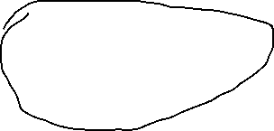
















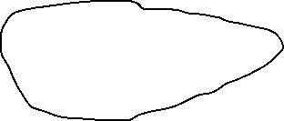




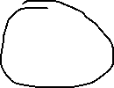








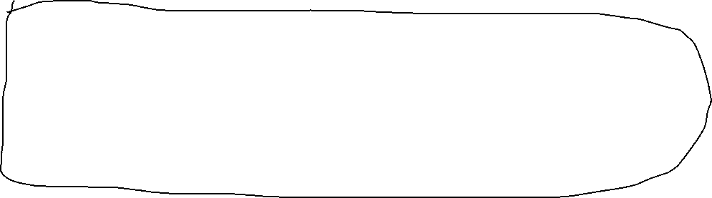


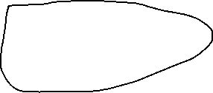

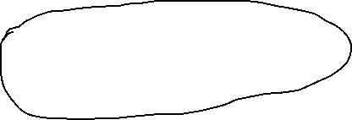


Slide 37
























Slide 38





